Slide 1
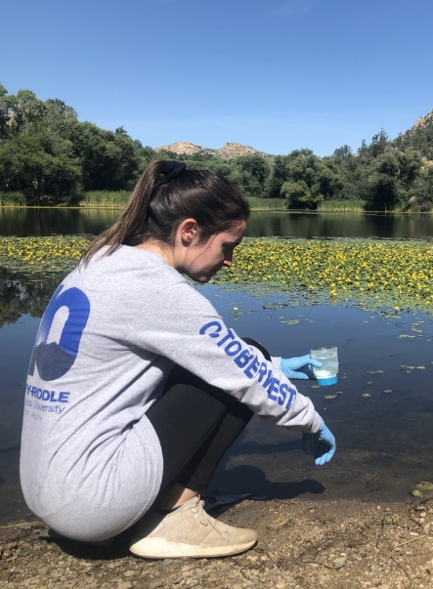
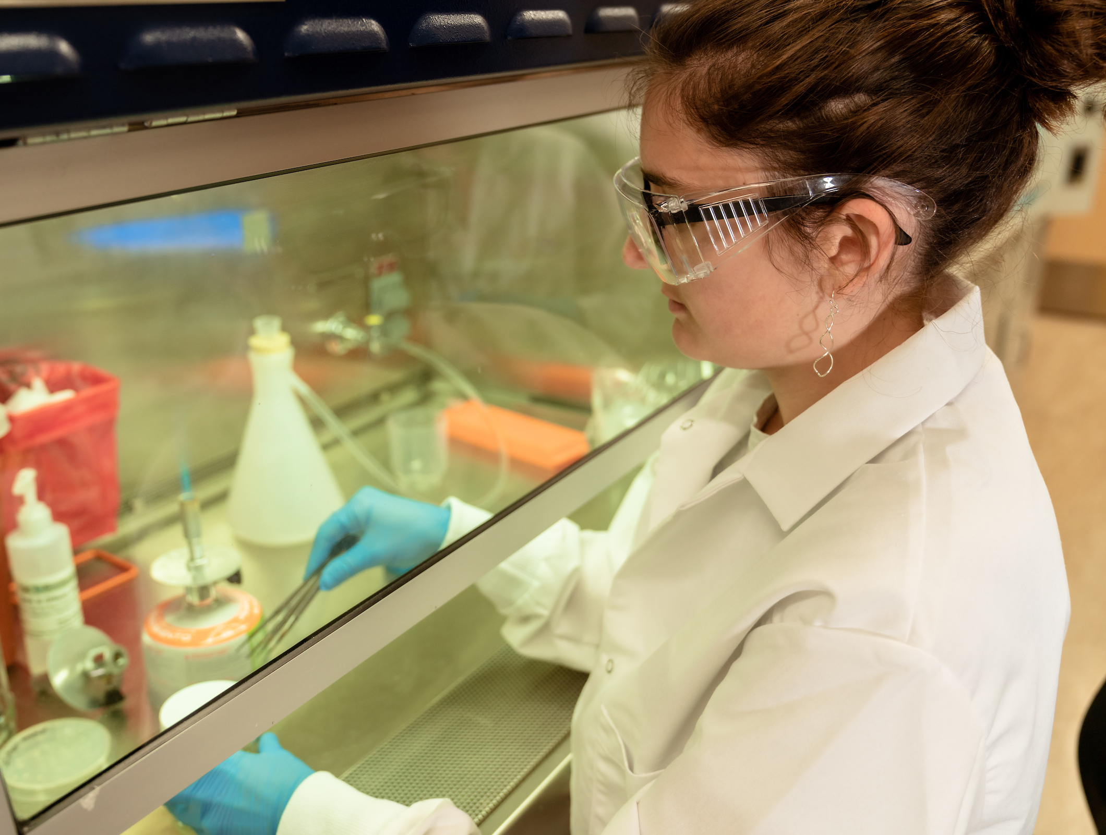
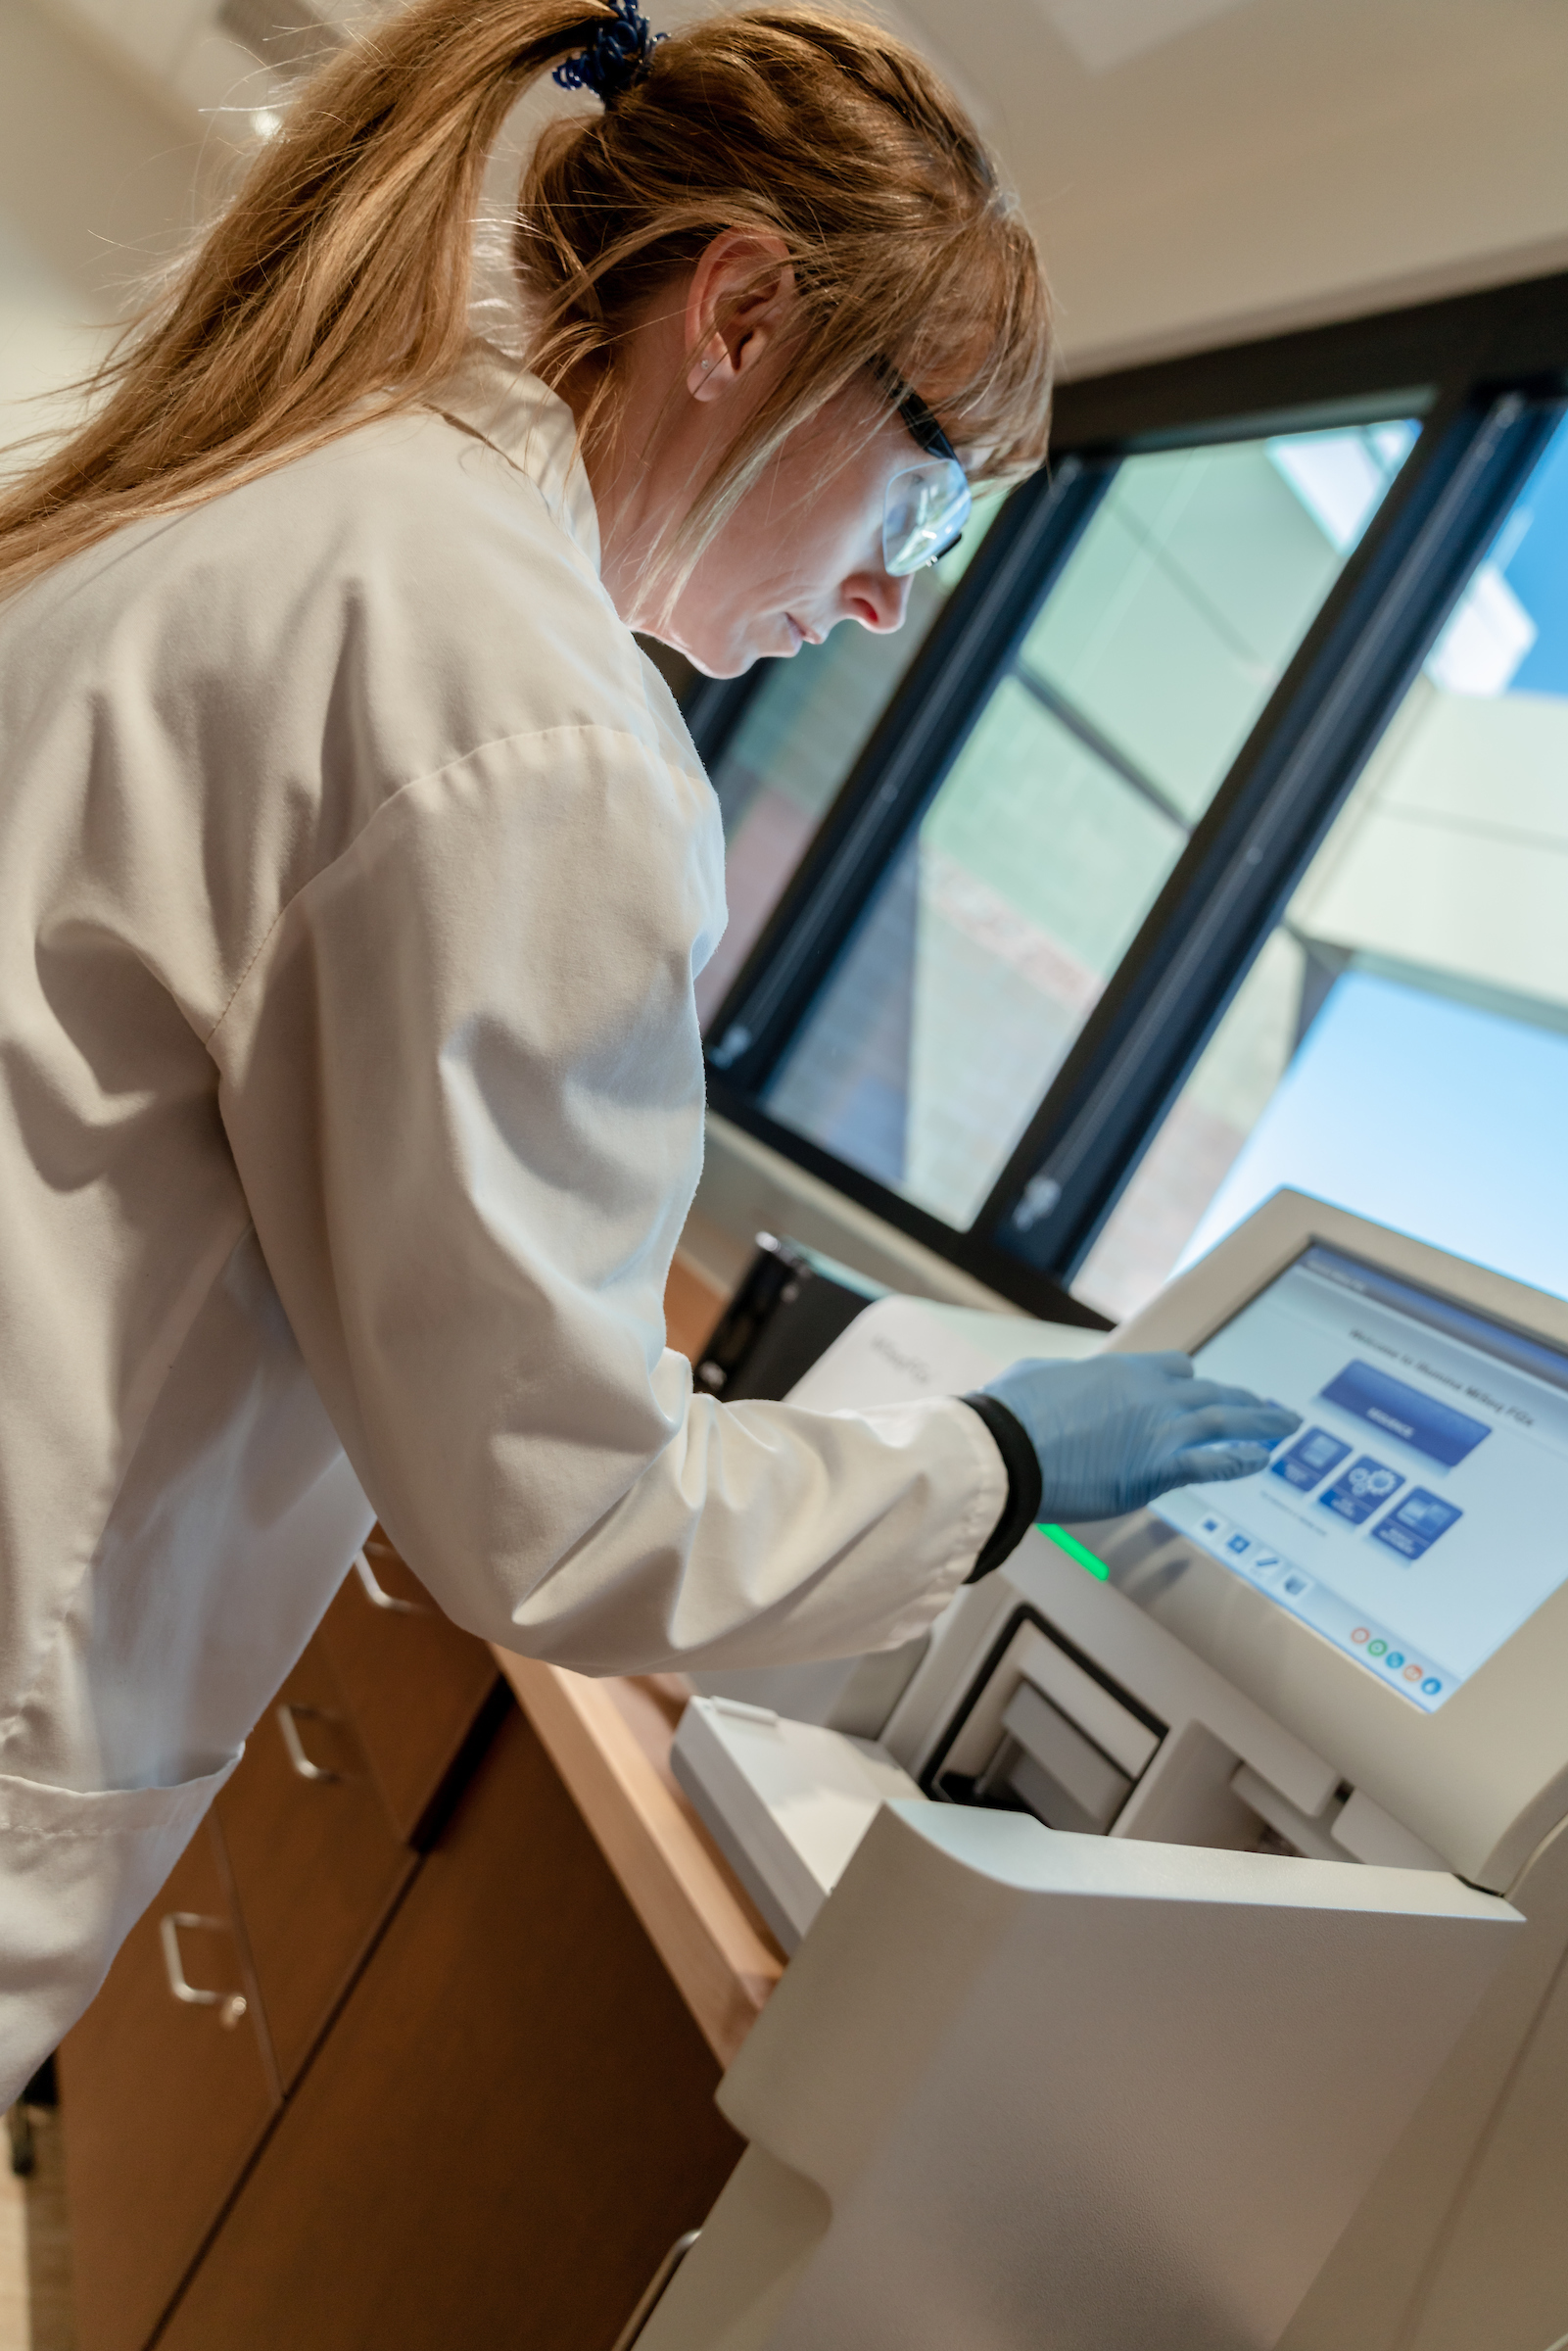

Metabarcoding across the Desert Southwest: Using
Environmental DNA to Track Fish and Wildlife Use of
Aquatic Ecosystems
Bethany Davis, Dr. Hillary Eaton, Dr. Katie Benson and Matthew Valente
Department of Biology and Chemistry

Slide 2
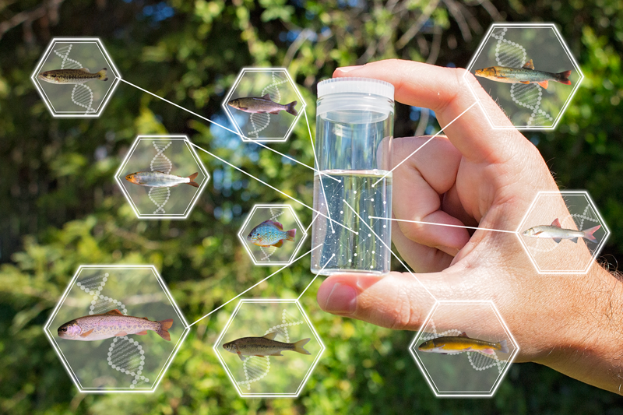
Environmental DNA (eDNA)
All organisms leave a genetic fingerprint in their environment, we can detect these in samples of air, water, and soil

Slide 3
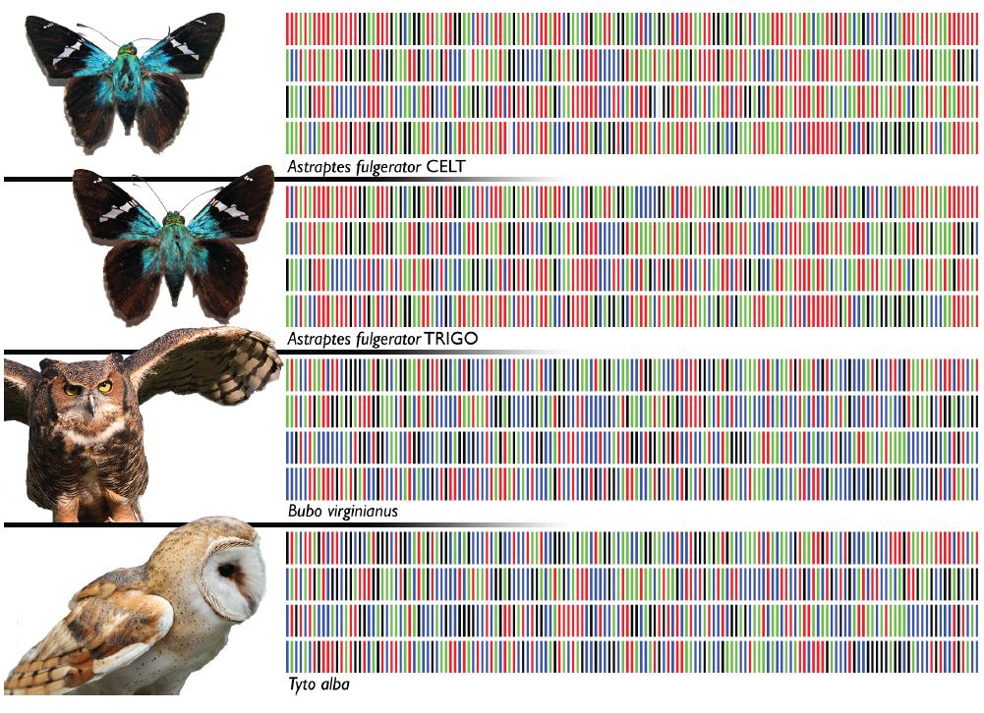
eDNA Metabarcoding
Targets entire taxonomic groups
Next-generation sequencing
Advantages
  Less stressful to target species
  Less time and money required
  Can detect rare and cryptic species

Slide 4
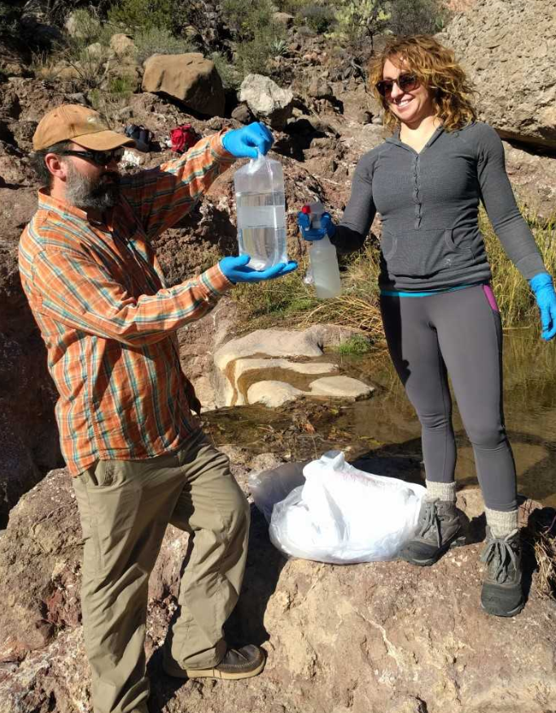
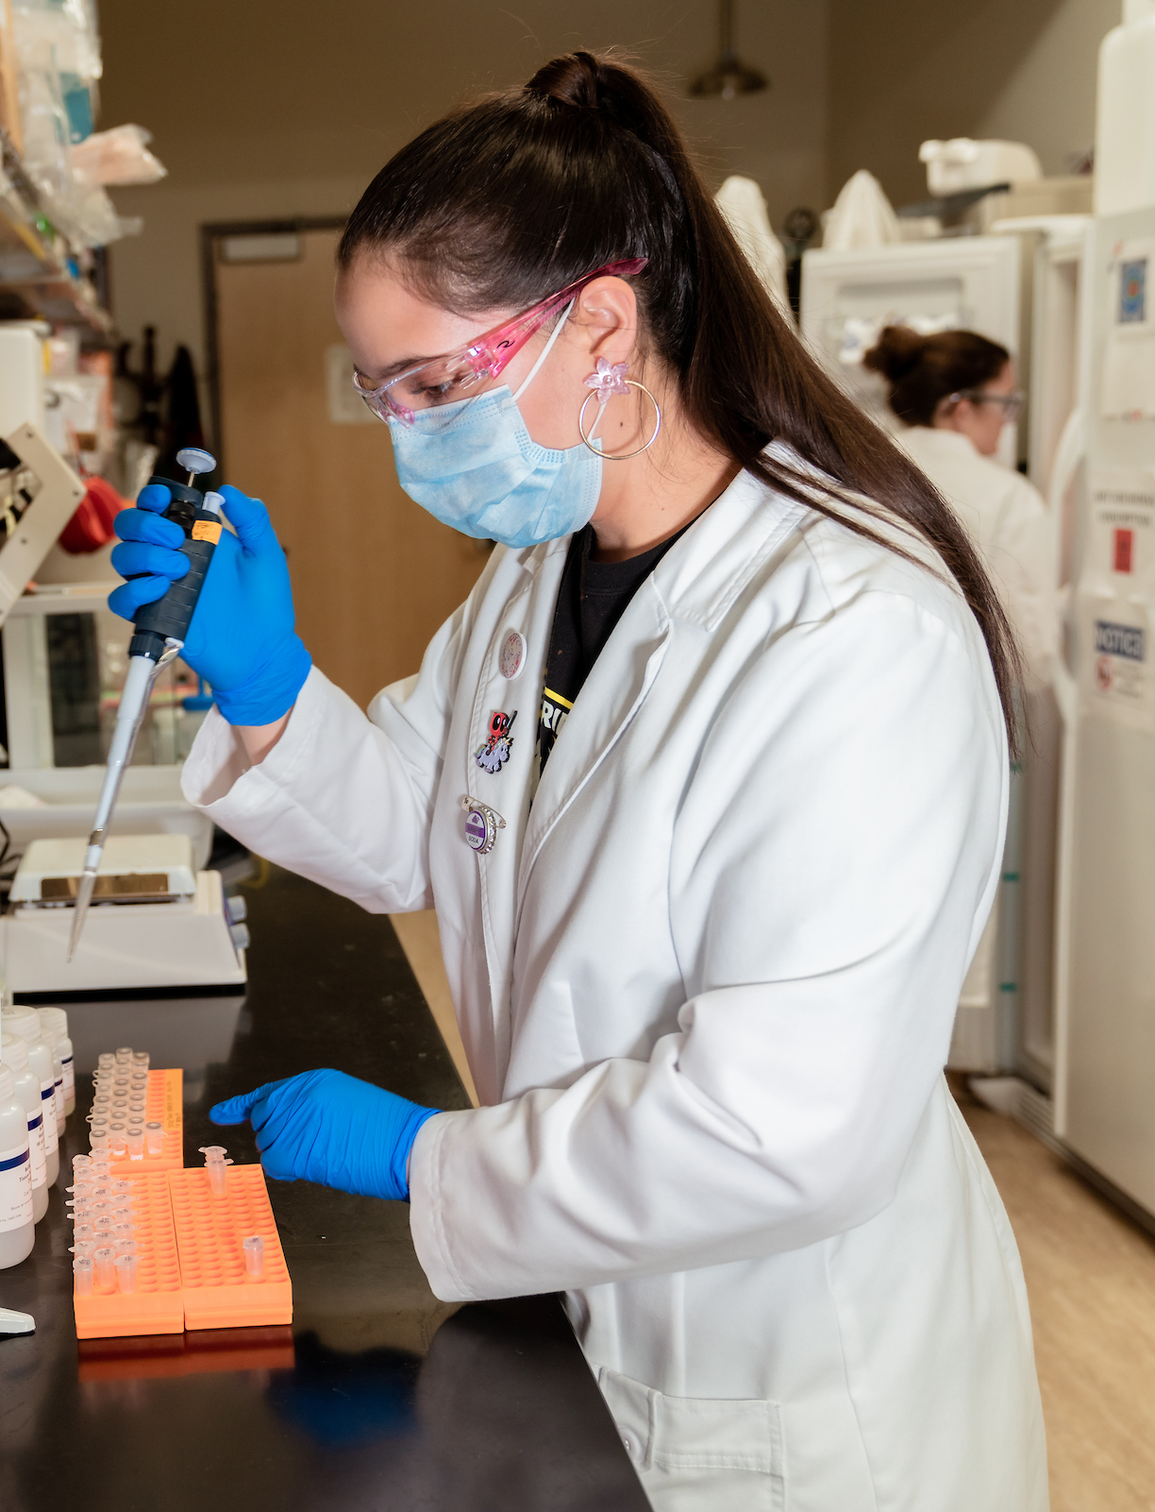
eDNA at Embry-Riddle
Designed a 16S rRNA mtDNA vertebrate metabarcoding protocol using universal primers (Vences et al. 2016)
Pilot studies in Central Arizona
  Verde River and Fossil Creek
  Watson and Willow Lakes
  Stock Tanks and Natural Springs in Prescott National Forest

Slide 5
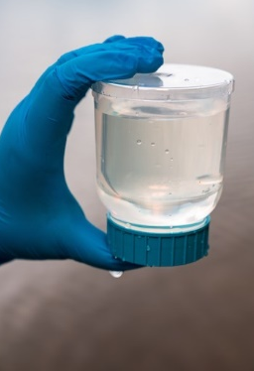
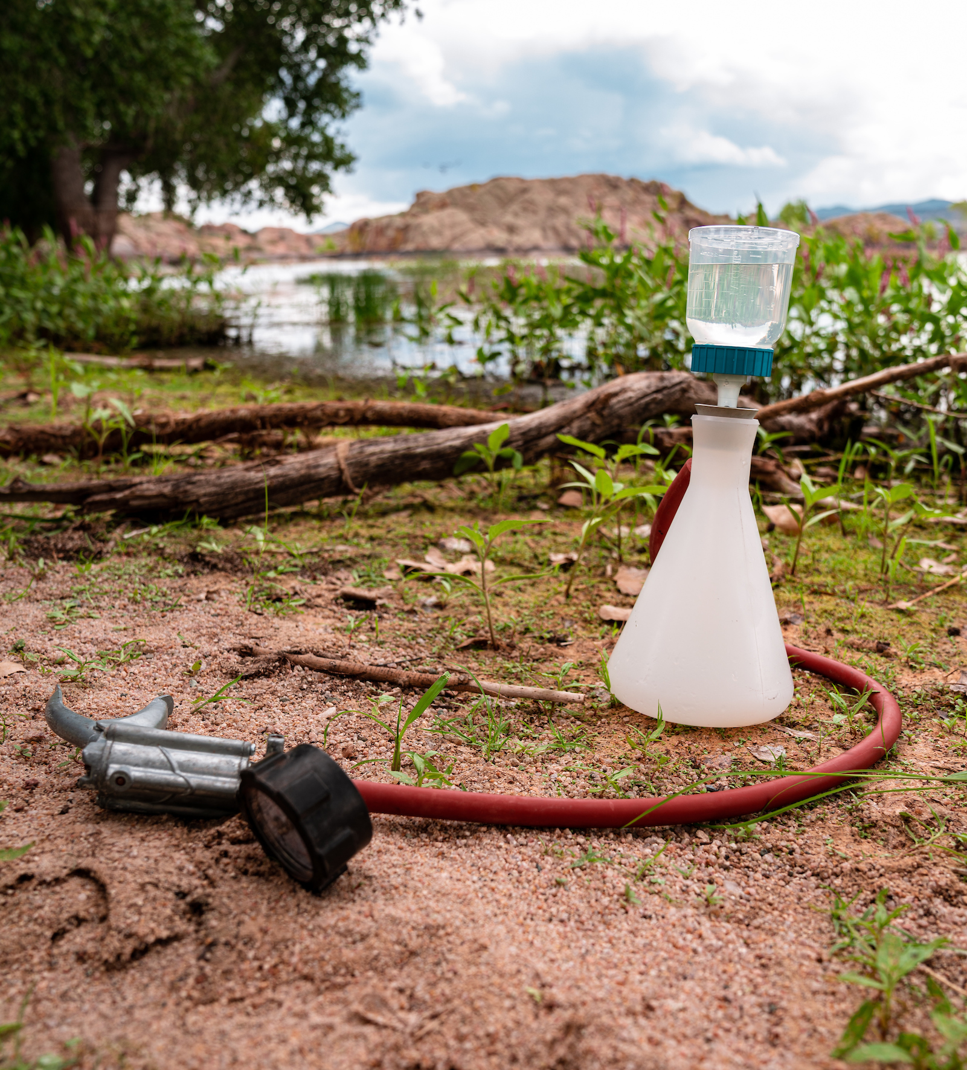
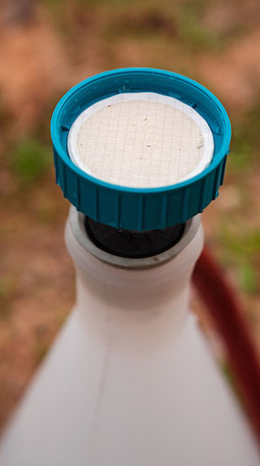
Sample collection protocols
Water samples collected in triplicate, volume is system-dependent

Slide 6
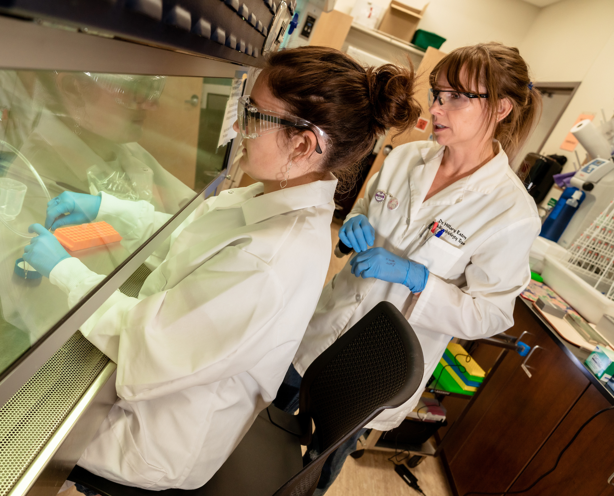
Laboratory protocols
Extract DNA from filter
PCR – amplify 16S rRNA gene
Sequencing – Illumina MiSeq FGx Forensic Genomics System
Bioinformatics
  Sequences clustered and identified using NCBI BLAST and GenBank Database

Slide 7
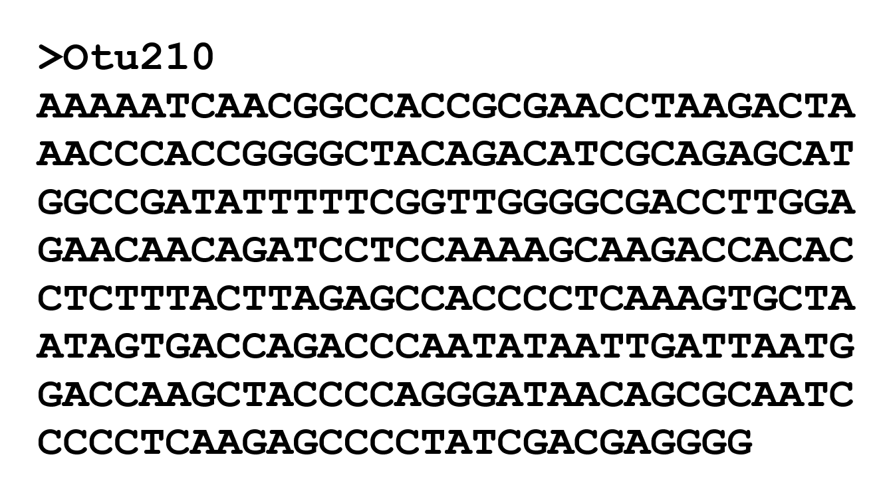

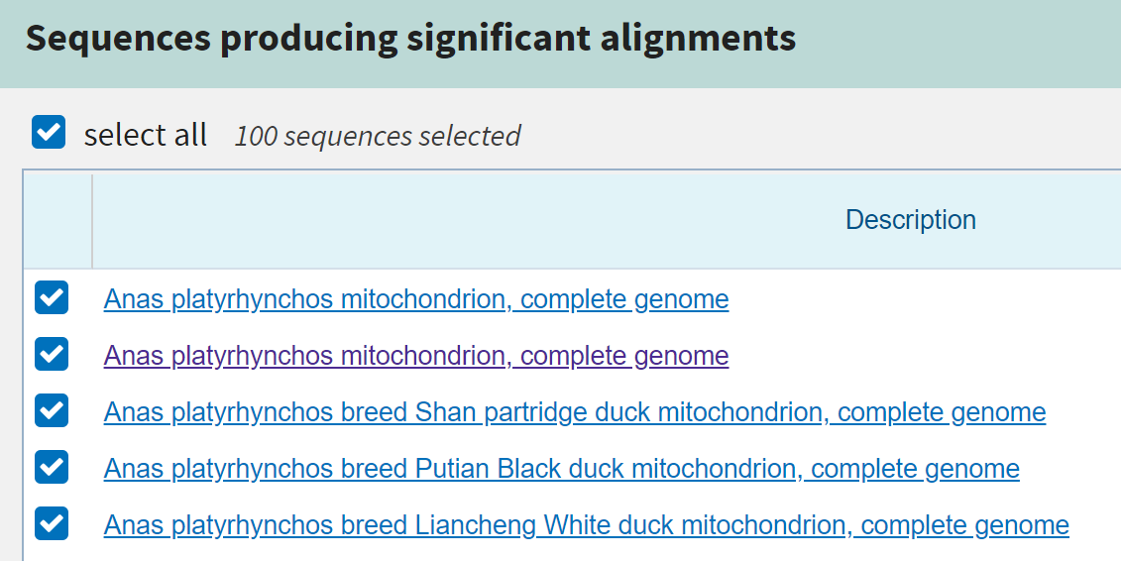
Bioinformatics
eDNA sequences clustered into operational taxonomic units (OTUs) at 97% similarity using USEARCH – identified using NCBI BLAST and GenBank Database

Slide 8
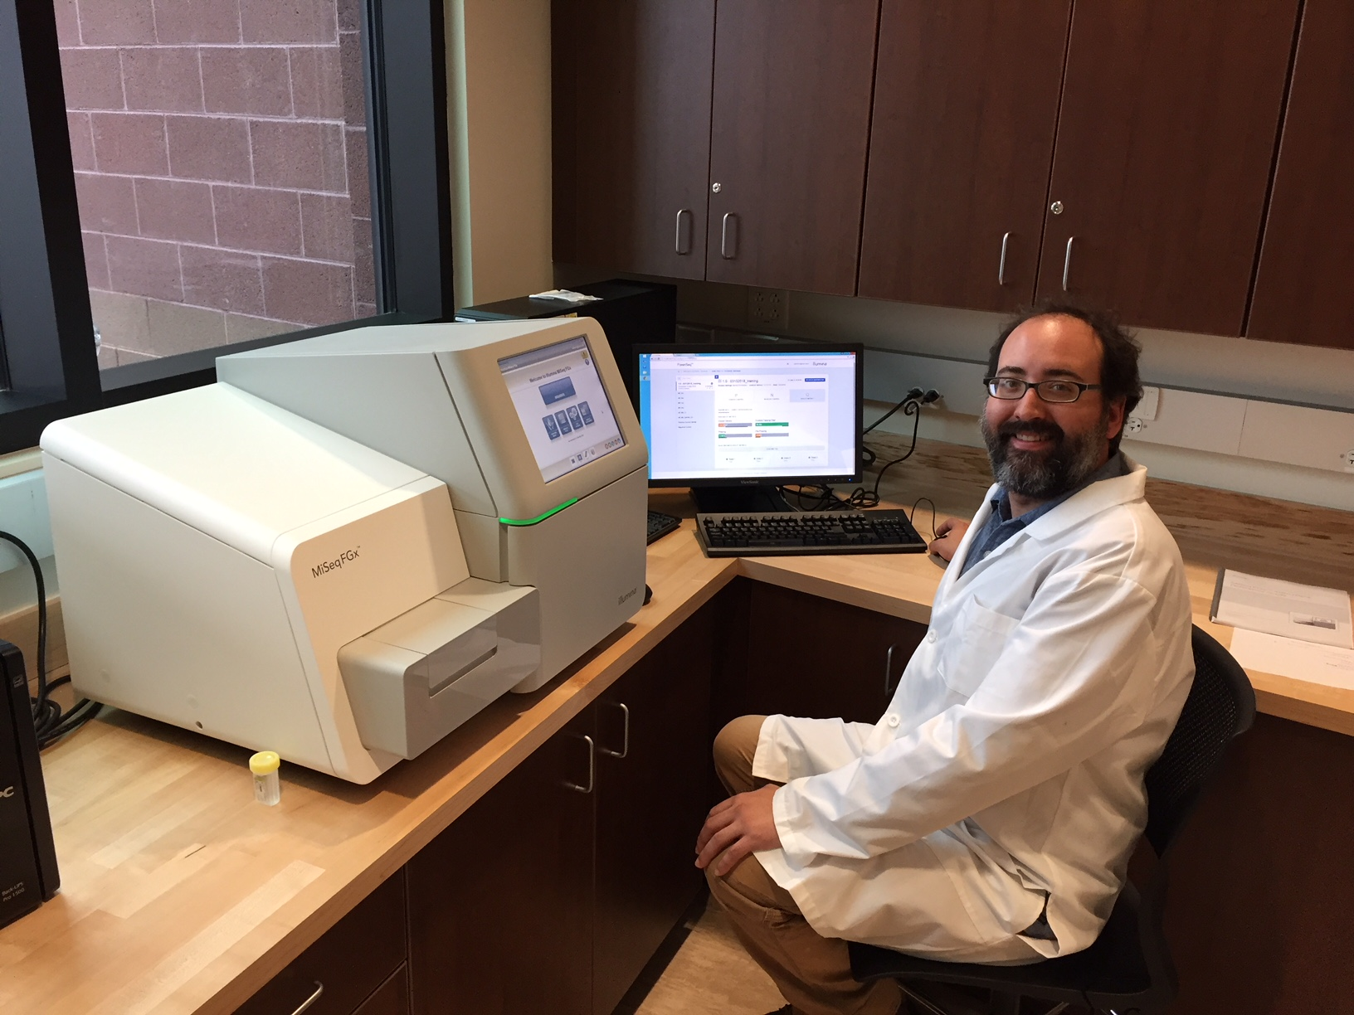
Results
Detected a total of 93 vertebrate species across all systems studied including:
  Aquatic species
  Facultative users of riparian areas
  Threatened and endangered species

Slide 9
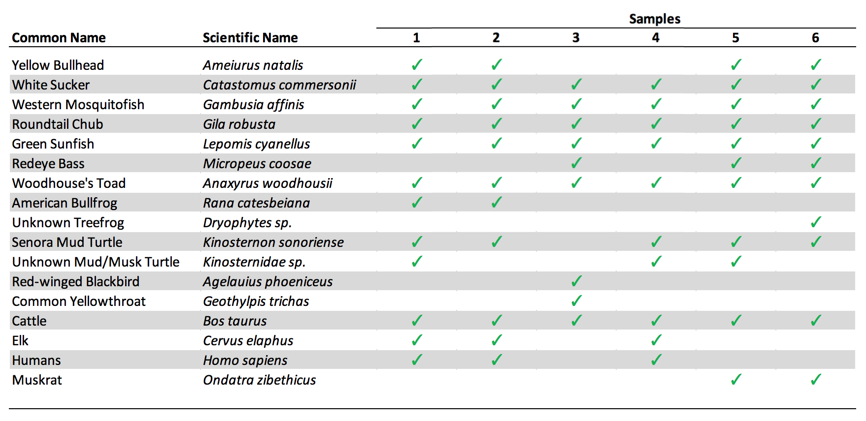
Upper Verde River
Notes:
Table: Results from samples collected from the Upper Verde River Wildlife Management Area (Paulden, AZ). Check marks represent which samples a species was detected in.

Slide 10
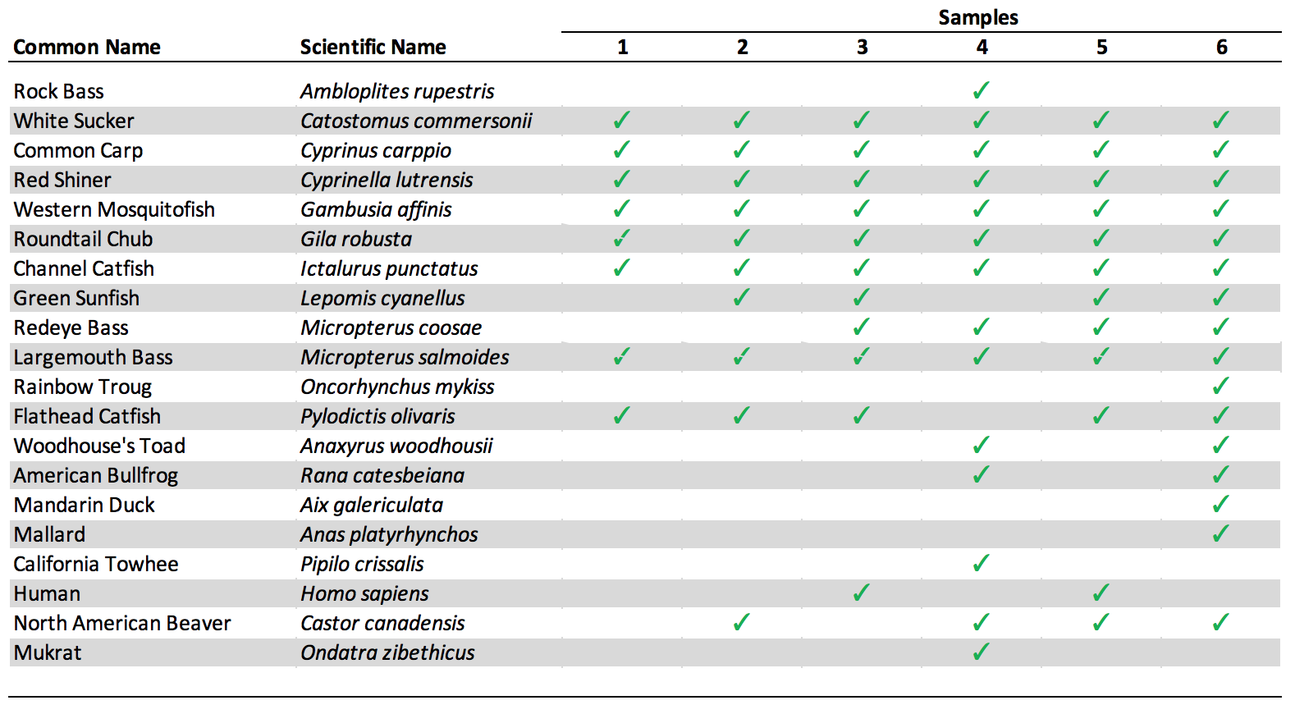
Camp Verde
Notes:
Table: Results from samples collected from the confluence of the Verde River and Beaver Creek (Camp Verde, AZ). Check marks represent which samples a species was detected in.

Slide 11
Verde River
Detected all species found by Arizona Game and Fish Department
  Species they did not: Western Mosquitofish (Gambusia affinis)
  Surprises: Mystery Bass (Micropterus sp.)
Several species were missing in GenBank
  Upper Verde – White Sucker, unknown treefrog and turtle species
  Camp Verde – Mandarin Duck and California Towhee

Slide 12
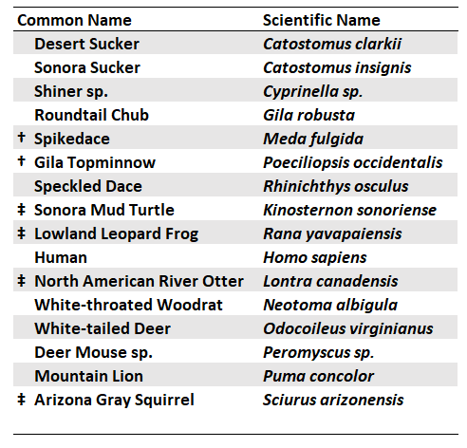
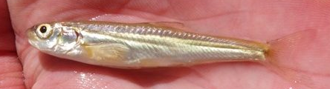
Fossil Creek
$10 million fish restoration
Can we detect T&E species?
  Both T&E fishes†
  Species of Conservation Need‡
  Facultative users
Notes:
Table: Results of species detected on Fossil Creek, a tributary of the Verde River (Strawberry, AZ). In 2004, Fossil Creek underwent a fish restoration project to repopulate the area with native fish species. Through eDNA metabarcoding, we were able to detect both of the threatened and endangered species, the Spikedace Meda fulgida and Gila Topminnow Poeciliopsis occidentalis. As well, we detected several species of conservation need the Sonora Mud Turtle Kinosternon sonoriense, Lowland Leopard Frog Rana yavapaiensis, North American River Otter Lontra canadensis, and the Arizona Gray Squirrel Sciurus arizonensis.

Slide 13
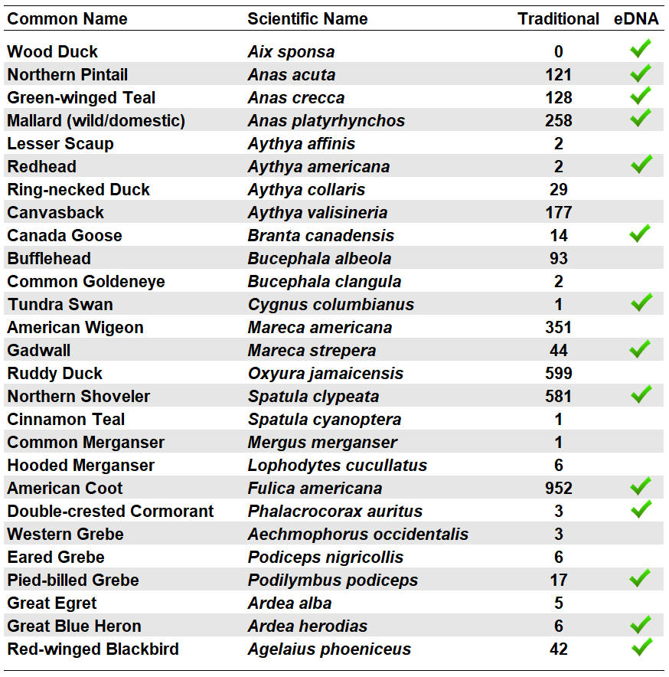
Willow Lake
Audubon Important Bird Area
  Prescott Audubon Society biennial waterbird surveys
Can we detect waterbirds?
  14/26 species from 11 L of water at 8 sites
  Wood Duck
  Unknown sequences
Notes:
Table: Results of eDNA detection of waterbirds at Willow Lake (Prescott, AZ) versus traditional survey count. We hypothesized we could detect 26 different species of waterbird species which are listed on this table. The traditional survey was performed with four teams of observers following the Prescott Audubon Society IBA survey protocol in November, 2018. A total of 30-wetland associated species were counted, and we hypothesized we could detect 26/30 using our eDNA metabarcoding protocol. A total of 14 species were detected including the Wood Duck Aix sponsa, which was not detected through traditional surveys. We had one unknown sequence, the Ruddy Shelduck which had one OTU with a match to Tadorna. There are many domestics in the area that are also unknown. This technique does not also distinguish between closely related species. The OTU assigned to the Green-winged Teal Anas crecca was also 100% to the Falcated Duck. The Falcated Duck is located in Eurasia, however, so we were able to hypothesize this detection as the Green-winged Teal

Slide 14
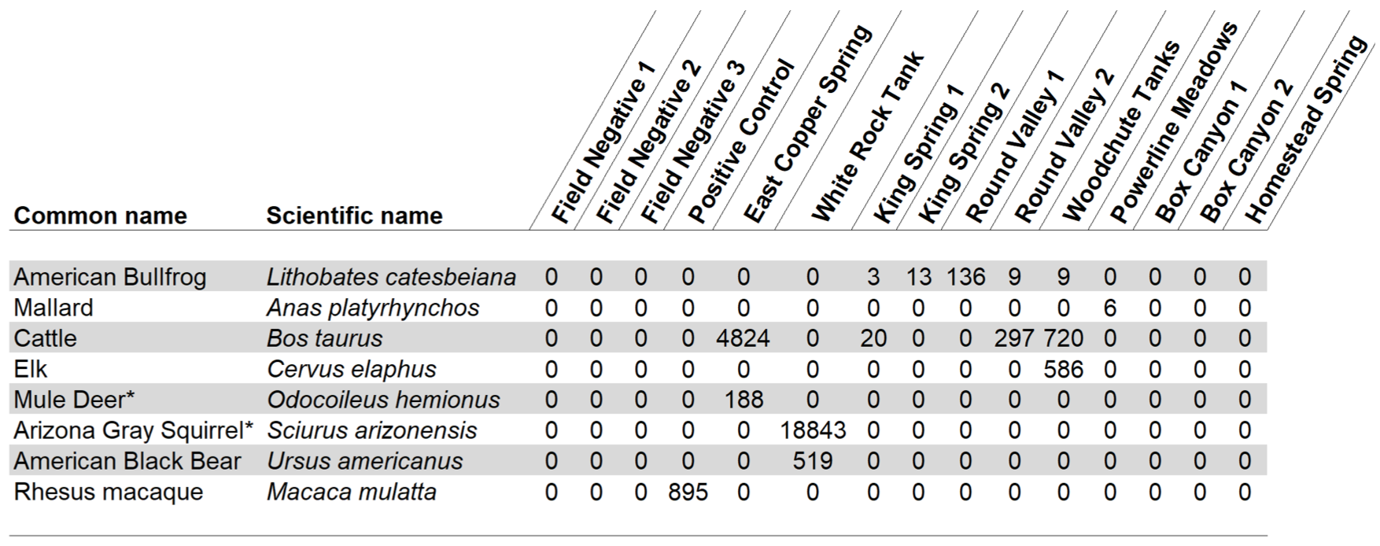
Stock Tanks and Natural Springs –
Prescott National Forest
Notes:
Table: Results of vertebrate detection in stock tanks and natural springs in the Prescott National Forest (Prescott, AZ). Field negative controls were collected during sample collection and carried through analysis, along with the positive control (Rhesus macaque DNA). Eight vertebrate species were detected from the 8 sites studied. The values listed represent the total number of eDNA sequences detected at the sample sites.
* The Mule Deer OTU was 100% match to the Mule Deer and the White-tailed Deer Odocoileus virginianus, suggesting shared haplotypes and the inability to distinguish between the two species with these primers. A reference 16S rRNA sequence for the Arizona Gray Squirrel is absent from GenBank. This listing is a hypothesis based on the OTU being a 96% match to other members of this genus and the tank being in a riparian area.

Slide 15
Stock Tanks and Natural Springs –
Prescott National Forest
8 vertebrate species detected from 8 sites
  5 natural springs
  3 stock tanks
1.9 million sequences generated during sequencing
  1.85 million belonged to invertebrates
Amplification of invertebrate eDNA associated with 16S primers may interfere with detection of vertebrate eDNA

Slide 16
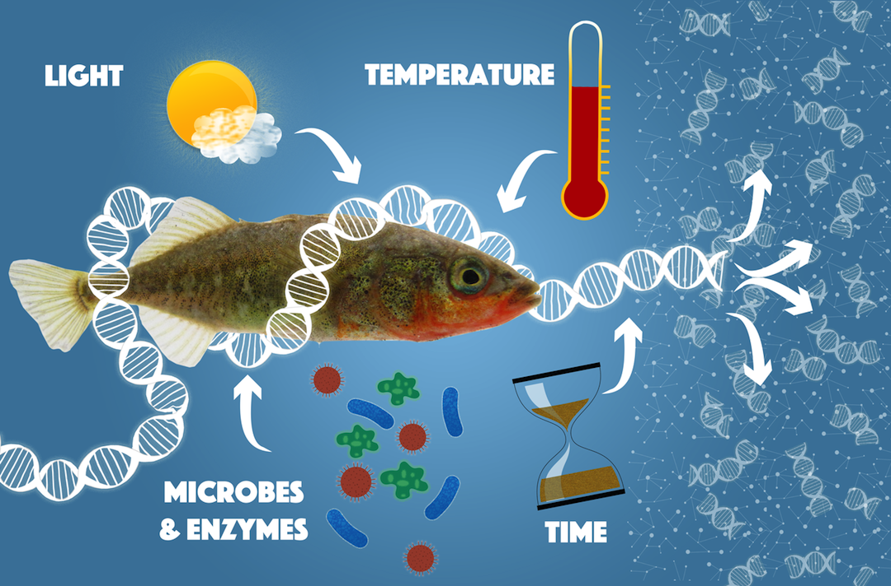
Discussion
Limitations
  Many species not in GenBank
  Not always species-specific
  Invertebrate detection
eDNA dynamics are complex
  Physical and chemical factors
  eDNA introductions

Slide 17
Conclusions
Powerful tool for monitoring vertebrate wildlife populations for wildlife management and conservation
Potentially use to monitor invertebrate populations
  Additional research needed

Slide 18
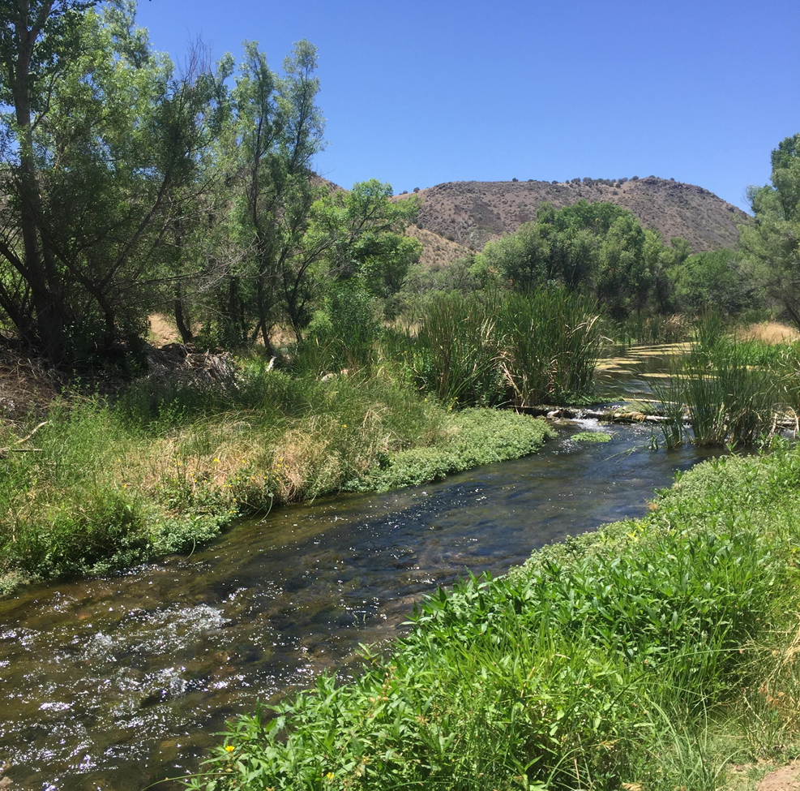
Future Projects
Current and future projects:
  Continue work on the Verde River
  eDNA versus traditional surveys
  Colorado River (Moab, Utah)
  Rietvlei Dam (Pretoria, South Africa)

Slide 19



Acknowledgements
Partners – Matthew Chmiel, Kris Stahr, and Gregg Cummins (Arizona Game and Fish Department), Matt O’Neill and Francisco Anaya (U.S. Forest Service)
Research Assistants – Berenice Andrea Carerras Mendiolea, Courtney Turner-Rathbone, and Anna Wockenfuss
Field Technicians – Jessica Geier, Sam Bellis, Maria Icenogle, Russ Smith, Mitchel Haug, Lee Lor, Gary Fussell, Jacqi Rollins, and Roycelynne Reble
ERAU colleagues – Dr. Anne Boettcher, Dr. Kathy Lustyk, and Dr. Quentin Bailey

